Slide 1

MAWLANA BHASANI SCIENCE AND TECHNOLOGY UNIVERSITY
Course: Software Engineering
Topic: Extreme Programming.
Submitted by : Submitted to :
Md.Lutfor Rahaman Dr. Ziaur Rahman
ID:IT-21047
3rd year 2nd semester Associate Professor
ICT, MBSTU

Slide 2
Contents
1. Overview
2. Details
3.Application
4. Advantage
5. Disadvantage

Slide 3
Overview
Extreme programming (XP) is one of the most important software development frameworks of Agile models. It is used to improve software quality and responsiveness to customer requirements.The extreme programming model recommends taking the best practices that have worked well in the past in program development projects to extreme levels.

Slide 4
Details
Extreme Programming (XP) is an Agile software development methodology that focuses on delivering high-quality software through frequent and continuous feedback, collaboration, and adaptation. XP emphasizes a close working relationship between the development team, the customer, and stakeholders, with an emphasis on rapid, iterative development and deployment.

Slide 5
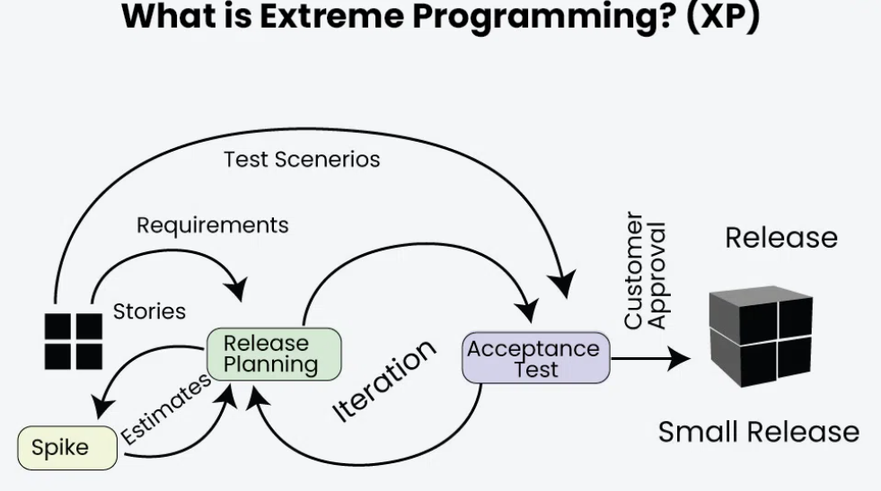

Slide 6
Agile approaches are based on some common principles, some of which are:
Working software is the key measure of progress in a project.
For progress in a project, therefore software should be developed and delivered rapidly in small increments.
Even late changes in the requirements should be entertained.
Face-to-face communication is preferred over documentation.
Continuous feedback and involvement of customers are necessary for developing good-quality software.
A simple design that involves and improves with time is a better approach than doing an elaborate design up front for handling all possible scenarios.
The delivery dates are decided by empowered teams of talented individuals.

Slide 7
Continuous feedback and involvement of customers are necessary for developing good-quality software.
A simple design that involves and improves with time is a better approach than doing an elaborate design up front for handling all possible scenarios.
The delivery dates are decided by empowered teams of talented individuals.
Extreme programming is one of the most popular and well-known approaches in the family of agile methods. an XP project starts with user stories which are short descriptions of what scenarios the customers and users would like the system to support. Each story is written on a separate card, so they can be flexibly grouped.

Slide 8
Applications
Some of the projects that are suitable to develop using the XP model are given below:
Small projects: The XP model is very useful in small projects consisting of small teams as face-to-face meeting is easier to achieve.
Projects involving new technology or Research projects: This type of project faces changing requirements rapidly and technical problems. So XP model is used to complete this type of project.
Web development projects: The XP model is well-suited for web development projects as the development process is iterative and requires frequent testing to ensure the system meets the requirements.
Collaborative projects: The XP model is useful for collaborative projects that require close collaboration between the development team and the customer.

Slide 9
Advantages
Slipped schedules: Timely delivery is ensured through slipping timetables and doable development cycles.
Misunderstanding the business and/or domain − Constant contact and explanations are ensured by including the client on the team.
Canceled projects: Focusing on ongoing customer engagement guarantees open communication with the consumer and prompt problem-solving.
.Business changes: Changes are accepted at any moment since they are seen to be inevitable.

Slide 10
Disadvantages
High commitment: XP requires a high level of commitment from customers, which may not always be feasible.
Time investment: XP can be a relatively large time investment.
Not suitable for all teams: XP is better suited to development teams that work and collaborate together.
Not highly focused on design: Some developers feel that XP focuses too much on the code and not enough on the design.

